Slide 1
Neonatal & Pediatric Respiratory Infections
Dr. Abhishek Mishra
Dept. Of Cardiovascular & Respiratory Physiotherapy
MGM Institute Of Physiotherapy
Chh. Sambhajinagar

Slide 2
OBJECTIVES
KNOW ABOUT THE CONDITION-BRIEF
PT MANAGEMENT

Slide 3
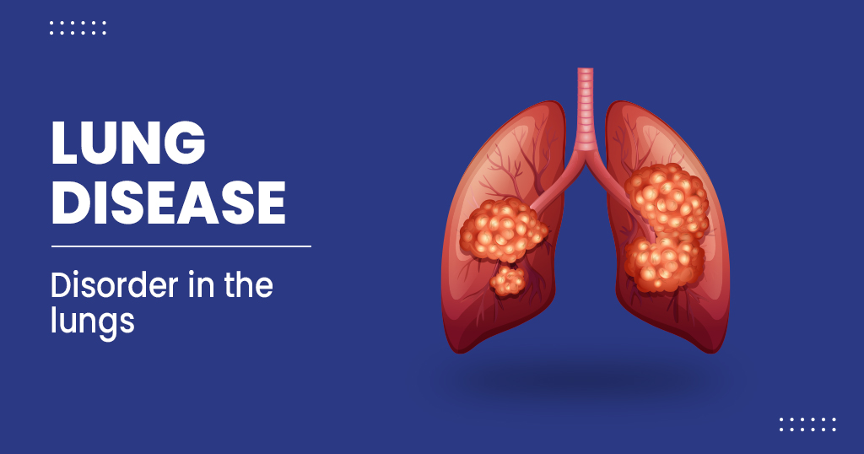

Slide 4
WHY?
Airways are narrower
Higher Larynx
Low compliance
Alveoli- immature structure & function, fewer no., thick walls
Diaphragm- type 1(FR 20%)
Ribcage- horizontal

Slide 5
CONDITIONS
ARDS
MECONIUM ASPIRATION
PNEMONITIS
PNEUMONIA
CHILDHOOD ASTHMA
CYSTIC FIBROSIS & CHRONIC LUNG DISEASE

Slide 6
ACUTE RESPIRATORY DISTRESS SYNDROME
  Clinical syndrome characterized by diffuse inflammation in the lung
  Results in significant hypoxemia from endothelial injury to the pulmonary vasculature and alveolar epithelial injury
  No definitive diagnostic test (i.e., biomarker) which is present in all cases (even histopathology inconsistent)

Slide 7
PALICC ARDS Definition
OI = oxygenation index = (FiO₂* mean airway pressure*100)/ PaO₂
OSI = oxygen saturation index = (FiO₂* mean airway pressure*100) /SpO₂
PALICC PCCM 2015

Slide 8
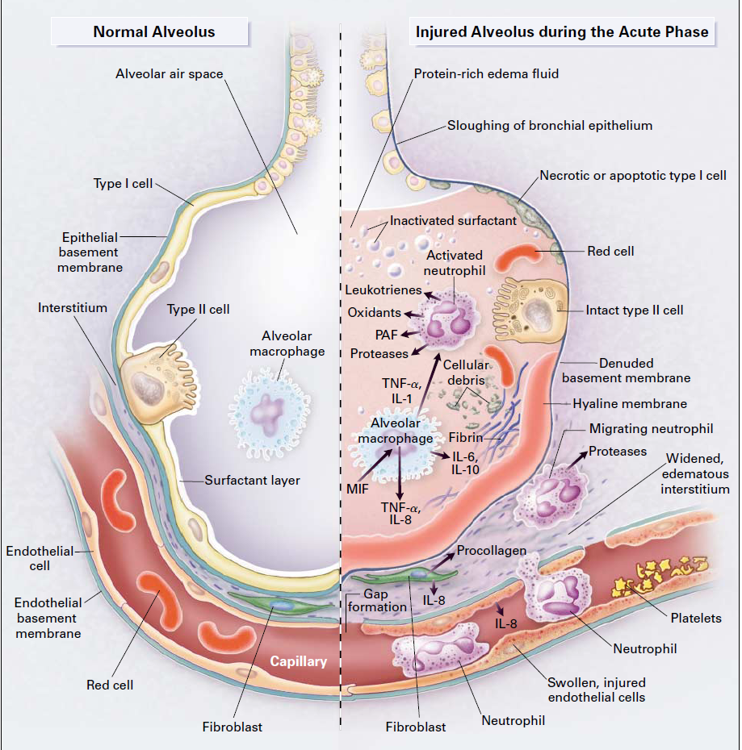

Slide 9
RDS results from lung immaturity, insufficient number of alveoli, and an inadequate amount of surfactant
Surfactant decreases alveolar surface tension and prevents alveoli collapse during expiration

Slide 10
MEDICAL MANAGEMENT
Antenatal corticosteroids and surfactant
oxygen therapy and assisted ventilation
Continuous positive airway pressure is an effective tool to treat children, including preterm and low‐birthweight infants, in respiratory distress (Kawaza 2014).

Slide 11
SYMPTOMS AND SEQUELAE OF RDS

Slide 12
MECONIUM ASPIRATION SYNDROME
Meconium is the content of fetal and newborn bowels
Meconium Aspiration Syndrome is an important cause of morbidity & mortality among term newborns.
Its is one of the commonest causes of respiratory morbidity in term newborns requiring NICU stay.

Slide 13
MAS is respiratory distress in a full-term or post-term neonate born through meconium-stained amniotic fluid (MSAF).
Oronasopharyngeal suctioning VS endotracheal intubation and suctioning

Slide 14
CLINICAL FEATURES
Partially or completely block the peripheral airways
Atelectasis, Hypoxemia, Hypercapnia, Surfactant Inactivation, Inflamatory Changes- classical findings
Hyperexpanded areas- partial blockage- air trapping in distal & small airways
Tension pneumothorax
Persistent pulmonary hypertension
Bronchiolitis
Meconium induced chemical pneumonitis

Slide 15
LONG TERM COMPLICATIONS
BRONCHOPULMONARY DYSPLASIA
SEIZURES
CEREBRAL PALSY
GLOBAL DELAYS

Slide 16
MEDICAL MANAGEMENT
Obligatory suction of the oral-pharyngeal cavity and nose before the first breath, and selective endotracheal suction only in depressed neonates or neonates born from thick meconium-stained amniotic fluid
Supplemental oxygen therapy (hood & nasal prongs), Mechanical ventilation, Extracorporeal Membrane oxygenation(ECMO)
Surfactant administration, antibiotics, sedation, normal fluid balance
High-frequency oscillatory or jet ventilation as a lifesaving therapy, use of exogenous surfactant, surfactant lavage of the bronchial tree, liquid ventilation, and inhalation of nitric oxide

Slide 17
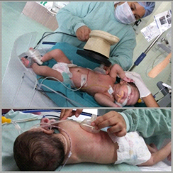
PT MANAGEMENT
Chest percussion: given by 3 fingers with the middle finger tented or a face mask striking repeatedly at a rate of 3 per second over that part of the bronchopulmonary segment which needs to be drained
Chest vibrations- manual using 2 fingers or tip of 3-4 fingers, mechanical vibrator with neonatal AMBU face mask as effective medium for intensity
PROM

Slide 18
CPT
Suctioning-oropharyngeal and nasopharyngeal
CPT frequency- every 4 hours followed by 3 times/day
Can also be give 1 hourly

Slide 19
PNEUMONIA
Pneumonia is the single‐biggest cause of death in children and was responsible for the deaths of 920,136 children aged up to five years in 2015
It accounted for 16% of all causes of deaths in this population, most of which were preventable (WHO 2016; Zar 2014)

Slide 20
Community‐acquired pneumonia is common among children globally, but incidence and mortality rates are significantly higher in low‐income countries (Principi 2011)
Hospital‐acquired pneumonia and ventilator‐associated pneumonia are the second most common hospital‐acquired infections (Rotstein 2008)
Aspiration pneumonia- indiscreet curiosity, gastroesophageal reflux, decreased upper airway neuromuscular control

Slide 21
CLINICAL FEATURES
Fever, Tachypnoea, Nasal Flaring, Cough, Breathlessness, Lower Chest Wall Indrawing, And Reduced Oxygen Saturation (Bradley 2011; Ebell 2010; Scott 2012)
The gold standard for diagnosing pneumonia according to clinical guidelines is the presence of lung infiltrates indicated by chest radiography (Evertsen 2010)

Slide 22
MEDICAL MANAGEMENT
ANTIBIOTICS
SUPPLEMENTAL OXYGEN THERAPY
NON-INVASIVE VENTILATION( CPAP<,bPAP)
MECHANICAL VENTILATION

Slide 23
PT MANAGEMENT
Postural drainage, vibration, percussion, huffing and coughing, and thoracic squeezing are conventional techniques that aim to facilitate mucociliary clearance (Flude 2012; Main 2005; Yang 2013; Yousefnia‐Darzi 2016)
Forced expiration, active cycle of breathing, autogenic drainage, assisted autogenic drainage, slow and prolonged expiration, increased expiratory flow, total slow expiration with the glottis open in a lateral posture, and inspiratory controlled flow exercises (Button 2013; Main 2005; Mckoy 2016; Mucciollo 2008; Postiaux 1997; Postiaux 2000; Yang 2013).

Slide 24
Non‐invasive ventilation, have been considered useful as adjunct therapy to airway clearance (Button 2016; Holland 2003)
A common instrumental technique of NIV is continuous positive airway pressure (CPAP).
Continuous positive airway pressure can be provided conventionally or as bubble CPAP (bCPAP) (Machen 2015)

Slide 25
CHILDHOOD ASTHMA
Asthma is a chronic inflammatory condition of the airways that is characterized by an increased responsiveness of the airway smooth muscle to various stimuli (due to a lowering of the threshold of airway smooth muscle reactivity)
It is manifested by widespread narrowing of the airways that reverses either spontaneously or as a result of treatment

Slide 26
During an asthma attack, the lumens of the airways are narrowed or occluded by a combination of bronchial smooth muscle spasm, inflammation of the mucosa, and overproduction of viscous mucus
Specifically, eosinophilic inflammation is prevalent, and airway remodelling of the bronchial airways occurs over time

Slide 27
TYPES OF ASTHMA
Allergic or Extrinsic Asthma
Nonallergic or Intrinsic Asthma
Exercise-induced asthma (EIA)
EIA appears to result from hyperosmolar changes or exposure to temperature changes in the airways. The condition can often be well controlled medically

Slide 28
Asthma flare is caused by three important changes in the airways that make breathing more difficult:
Inflammation of the airways
Excess mucus that results in congestion and mucus “plugs” that get caught in the narrowed airways
Narrowed airways or broncho constriction (bands of muscle lining the airways tighten up)

Slide 29
Common Childhood Asthma Signs And Symptoms
Frequent, intermittent coughing
A whistling or wheezing sound when exhaling
Shortness of breath
Chest congestion or tightness
Chest pain, particularly in younger children

Slide 30
Trouble sleeping caused by shortness of breath, coughing or wheezing
Bouts of coughing or wheezing that get worse with a respiratory infection, such as cold or flu
Delayed recovery or bronchitis after a respiratory infection
Trouble breathing that may limit play or exercise
Fatigue, which can be caused by poor sleep

Slide 31
PT MANAGEMENT
Breathing Control Guide
Help Children In Relaxation Position
Pursed – Lip Breathing exercise
Diaphragmatic Breathing exercises
Thoracic Expansion Exercise (TEE)
Thoracic Mobility Exercise (TME)

Slide 32
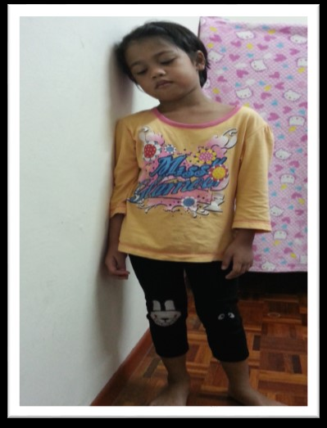
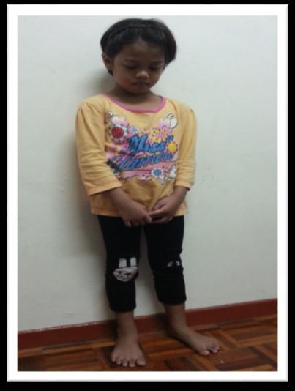
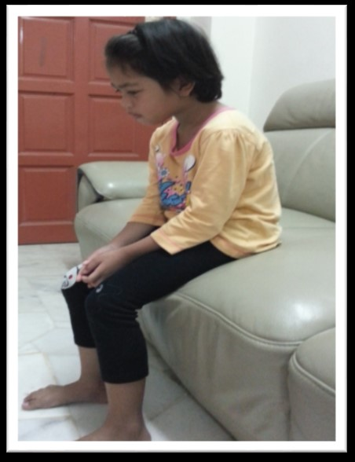
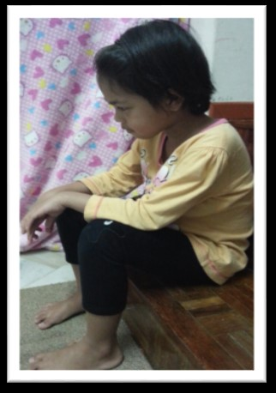
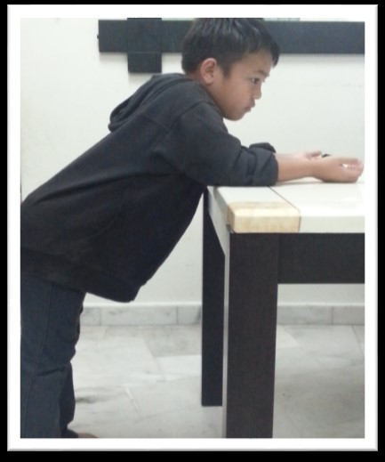
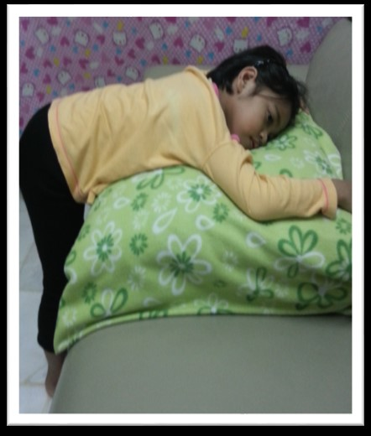
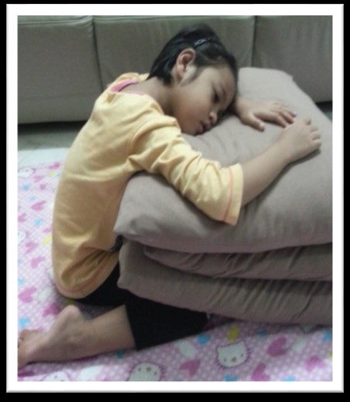
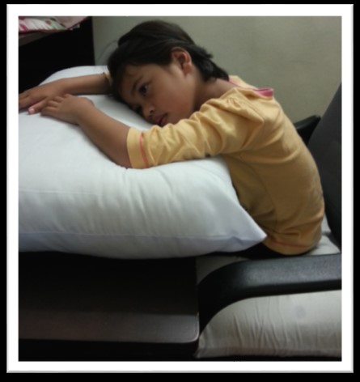

Slide 33
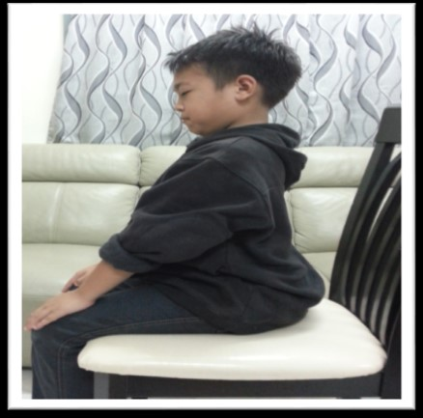
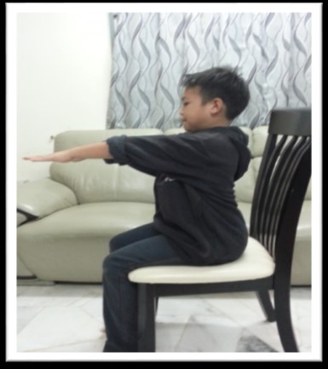
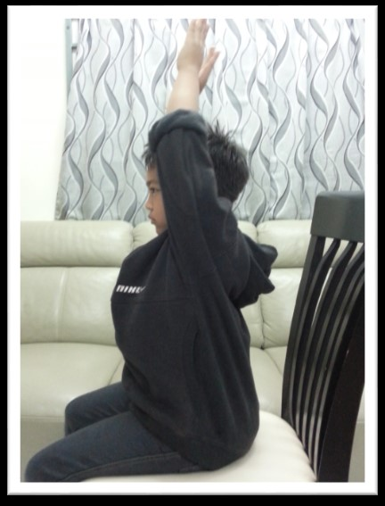
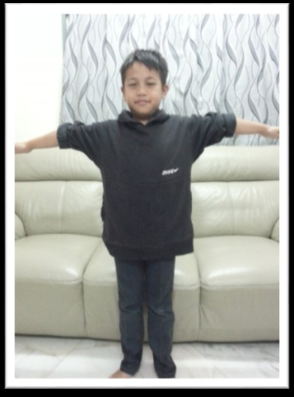
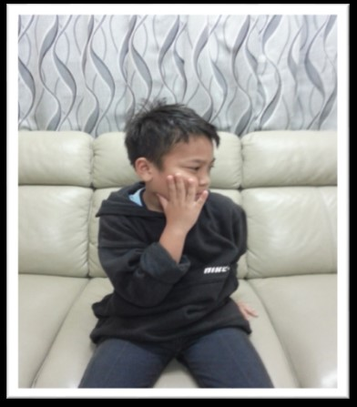

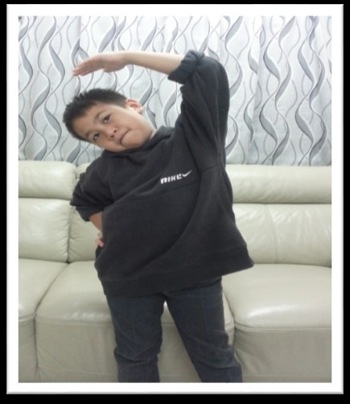

Slide 34
BRONCHOPULMONARY DYSPLASIA
Infants who remain oxygen-dependent and have abnormal findings on chest radiograph are described as having BPD
BPD covers a broad range of disease, and a variety of terminology has been used to describe this disorder, including CLD
Reported incidence of BPD varies from 15% to 50%,
Mild, Moderate and Severe, depending on oxygen and positive pressure requirement

Slide 35
RISK FACTORS
Prematurity-neonatal respiratory distress,
Low-birthweight
Mechanical Ventilation(Barotrauma)
Oxygen Therapy(AIR)
PDA
Infections

Slide 36
MEDICAL MANAGAMENT
Ventilatory support
Supplementary oxygen
Diuretics
Bronchodilators
Steroids
Antibiotics

Slide 37
PT MANAGEMNT
PD Positioning
Chest PT
Airway Clearance Techniques
Suctioning
Humidification

Slide 38
CYSTIC FIBROSIS
Cystic fibrosis (CF) is a genetic disorder that affects the respiratory, digestive, and reproductive systems
It is caused by mutations in the CF transmembrane conductance regulator (CFTR)CFTR gene that leads to the production of a defective protein that affects the movement of salt and water in and out of cells

Slide 39
CAUSES
CF is an inherited disorder that is caused by a mutation in the CFTR gene.
A child needs to inherit two copies of the mutated gene (one from each parent) to develop CF.
If a child inherits only one mutated gene, he or she will be a carrier of the disease but will not develop it

Slide 40
SYMPTOMS
Persistent coughing, wheezing, and shortness of breath
Frequent lung infections
Thick, sticky mucus production
Poor growth and weight gain
Greasy, foul-smelling stools
Chronic sinus infections
Clubbing of fingers and toes

Slide 41
DIAGNOSIS
New-born screening: All new-borns in the United States are screened for CF using a blood test
Sweat test: This test measures the amount of salt in the sweat, which is higher in people with CF.
Genetic testing: This test can identify mutations in the CFTR gene

Slide 42
TREATMENT
There is no cure for CF, but treatments can help manage the symptoms and improve the quality of life for children with CF.
Medications: Antibiotics to treat lung infections, mucus-thinning drugs, and bronchodilators to open the airways.
Nutrition therapy: Children with CF need a high-calorie, high-protein diet to help them grow and maintain a healthy weight.
Lung transplant: In severe cases, a lung transplant may be necessary.

Slide 43
PT MANAGEMENT
Chest Physiotherapy (CPT): This involves the use of different techniques, such as percussion, vibration, and postural drainage, to help loosen and clear mucus from the lungs
Airway clearance devices: There are various devices available, such as positive expiratory pressure (PEP) devices, oscillatory positive expiratory pressure (OPEP) devices, and high-frequency chest wall oscillation (HFCWO) devices, that can help clear mucus from the lungs

Slide 44
Breathing techniques: Techniques such as deep breathing, pursed-lip breathing, and huffing can help clear mucus from the lungs and improve breathing
Exercise: Regular exercise is important for people with CF, as it can improve lung function and overall health. A physiotherapist can work with the patient to develop an exercise program that is safe and effective
Aerobic, resistance, HIIT, Circuit Training

Slide 45
PATIENT EDUCATON
Education: Physiotherapists can educate patients and their families about the importance of airway clearance and exercise, as well as how to perform CPT and use airway clearance devices correctly
Follow the treatment plan: Children with CF need to take medications, perform airway clearance techniques, and maintain a healthy diet as prescribed by their healthcare providers

Slide 46
Stay up to date with vaccinations: Children with CF are at a higher risk of developing complications from infections, so it is important to stay up to date with vaccinations
Monitor symptoms: Parents and healthcare providers should monitor symptoms closely and seek medical attention if they worsen

